Slide 1
MATHEMATICS OF PUBLIC KEY CRYPTOGRAPHY

Slide 2
Euler’s Phi-Function
Euler’s phi-function, φ (n), which is sometimes called the Euler’s totient function plays a very important role in cryptography.
The function finds the number of integers that are both smaller than n and relatively prime to n

Slide 3
Euler’s Phi-Function(cont.)
We can combine the above four rules to find the value of φ(n). For example, if n can be factored as
n = p₁^{e1} × p₂^{e2} × … × p_{k}^{ek}
Then we combine the third and the fourth rule to find
The difficulty of finding φ(n) depends on the difficulty of finding the factorization of n.

Slide 4
Euler’s Phi-Function(cont.)
Example 1
What is the value of φ(13)?
Solution
Because 13 is a prime, φ(13) = (13 −1) = 12.
Example 2
What is the value of φ(10)?
Solution
We can use the third rule: φ(10) = φ(2) × φ(5) = 1 × 4 = 4, because 2 and 5 are primes.

Slide 5
Euler’s Phi-Function(cont.)
Example 3
What is the value of φ(240)?
Solution
We can write 240 = 2⁴ × 3¹ × 5¹. Then
φ (240) = (2⁴ −2³) × (3¹ − 3⁰) × (5¹ − 5⁰) = 64
Example 4
Can we say that φ (49) = φ (7) × φ (7) = 6 × 6 = 36 ????

Slide 6
Euler’s Phi-Function(cont.)
Example 3
What is the value of φ(240)?
Solution
We can write 240 = 2⁴ × 3¹ × 5¹. Then
φ (240) = (2⁴ −2³) × (3¹ − 3⁰) × (5¹ − 5⁰) = 64
Example 4
Can we say that φ (49) = φ (7) × φ (7) = 6 × 6 = 36????
Solution
No. The third rule applies when m and n are relatively prime. Here 49 = 7². We need to use the fourth rule: φ (49) = 7² − 7¹ = 42.

Slide 7
Euler’s Phi-Function(cont.)
Example 5
What is the number of elements in Z₁₄*?
Solution
The answer is φ(14) = φ (7) × φ (2) = 6 × 1 = 6. The members are 1, 3, 5, 9, 11, and 13.
Interesting point: If n > 2, the value of φ(n) is even.

Slide 8
Euler’s Theorem
First Version
If a and n are coprime,
Second Version
Removes the condition that a and n should be coprime
a^{φ(n)} ≡ 1 (mod n)
a ^{k × φ(n) + 1} ≡ a (mod n)
The second version of Euler’s theorem is used in the RSA cryptosystem

Slide 9
Euler’s Theorem(cont.)
Example 1
Find the result of 6²⁴ mod 35.
Solution
We have 6²⁴ mod 35 = 6^{φ (35)} mod 35 = 1.
Example 2
Find the result of 20⁶² mod 77???

Slide 10
Euler’s Theorem(cont.)
Example 1
Find the result of 6²⁴ mod 35.
Solution
We have 6²⁴ mod 35 = 6^{φ (35)} mod 35 = 1.
Example 2
Find the result of 20⁶² mod 77.
Solution
If we let k = 1 on the second version, we have
20⁶² mod 77 = (20 mod 77) (20^{φ (77)} ⁺ ¹ mod 77) mod 77
= (20)(20) mod 77 = 15.

Slide 11
Euler’s Theorem(cont.)
Multiplicative Inverses
Euler’s theorem can be used to find multiplicative inverses modulo a composite.
a⁻¹ mod n = a^{φ(n)−1} mod n

Slide 12
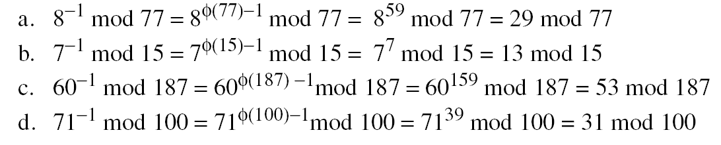
Euler’s Theorem(cont.)
Example
The answers to multiplicative inverses modulo a composite can be found without using the extended Euclidean algorithm if we know the factorization of the composite:

Slide 13
Fermat’s Little Theorem
First Version
If p is a prime and a is an integer such that p does not divide a,
Second Version
Removes the condition on a
If p is prime and a is an integer,
a^{p − 1} ≡ 1 mod p
a^{p} ≡ a mod p

Slide 14
Fermat’s Little Theorem(cont.)
Example 1
Find the result of 6¹⁰ mod 11.
Solution
We have 6¹⁰ mod 11 = 1. This is the first version of Fermat’s little theorem where p = 11.
Example 2
Find the result of 3¹² mod 11.
Solution

Slide 15
Fermat’s Little Theorem(cont.)
Example 1
Find the result of 6¹⁰ mod 11.
Solution
We have 6¹⁰ mod 11 = 1. This is the first version of Fermat’s little theorem where p = 11.
Example 2
Find the result of 3¹² mod 11.
Solution
Here the exponent (12) and the modulus (11) are not the same. With substitution this can be solved using Fermat’s little theorem.

Slide 16
Fermat’s Little Theorem(cont.)
Multiplicative Inverses
The answers to multiplicative inverses modulo a prime can be found without using the extended Euclidean algorithm:
a⁻¹ mod p = a ^{p − 2} mod p

Slide 17
CHINESE REMAINDER THEOREM
Used to solve a set of congruent equations with one variable but different moduli, which are relatively prime

Slide 18
Continued…
Example
The following is an example of a set of equations with different moduli:
The solution to this set of equations is given in the next section; for the moment, note that the answer to this set of equations is x = 23. This value satisfies all equations: 23 ≡ 2 (mod 3), 23 ≡ 3 (mod 5), and 23 ≡ 2 (mod 7).

Slide 19
Continued…
Solution To Chinese Remainder Theorem
Find M = m₁ × m₂ × … × m_{k}. This is the common modulus.
Find M₁ = M/m₁, M₂ = M/m₂, …, M_{k} = M/m_{k}.
Find the multiplicative inverse of M₁, M₂, …, M_{k} using the corresponding moduli (m₁, m₂, …, m_{k}). Call the inverses M₁⁻¹, M₂⁻¹, …, M_{k} ⁻¹.
The solution to the simultaneous equations is

Slide 20
Continued…
Example
Find the solution to the simultaneous equations:
Solution: We follow the four steps.
1. M = 3 × 5 × 7 = 105
2. M₁ = 105 / 3 = 35, M₂ = 105 / 5 = 21, M₃ = 105 / 7 = 15
3. The inverses are M₁⁻¹ = 2, M₂⁻¹ = 1, M₃ ⁻¹ = 1
4. x = (2 × 35 × 2 + 3 × 21 × 1 + 2 × 15 × 1) mod 105 = 23 mod 105

Slide 21
Continued…
Example
Find an integer that has a remainder of 3 when divided by 7 and 13, but is divisible by 12.
Solution ????

Slide 22
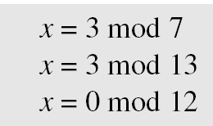
Continued…
Example
Find an integer that has a remainder of 3 when divided by 7 and 13, but is divisible by 12.
Solution
This is a CRT problem. We can form three equations and solve them to find the value of x.
If we follow the four steps, we find x = 276. We can check that 276 = 3 mod 7, 276 = 3 mod 13 and 276 is divisible by 12 (the quotient is 23 and the remainder is zero).

Slide 23
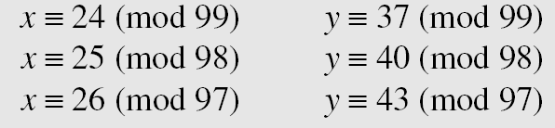
Continued…
Assume we need to calculate z = x + y where x = 123 and y = 334, but our system accepts only numbers less than 100. These numbers can be represented as follows:
Adding each congruence in x with the corresponding congruence in y gives
Now three equations can be solved using the Chinese remainder theorem to find z. One of the acceptable answers is z = 457.

Slide 24
Continued…
Secret Sharing scheme in cryptography aims to distribute and later recover secret S among n parties. Secret S is distributed in form of shares which are generated from secret. Without cooperation of k no. of parties, the secret cannot be reconstructed from shares directly. Consider the following example:
Say our secret is S. The shares for n=4 no. of parties are generated taking modulus 11,13,17 and 19. They are respectively 1,12,2 and 3 and given by following equations:
Now, from four possible sets of k=3 shares (as k shares are necessary to reconstruct the secret), consider one possible set {1, 12, 2} and recover the secret S from it.

Slide 25
Continued…
Secret Sharing scheme in cryptography aims to distribute and later recover secret S among n parties. Secret S is distributed in form of shares which are generated from secret. Without cooperation of k no. of parties, the secret cannot be reconstructed from shares directly. Consider the following example:
Say our secret is S. The shares for n=4 no. of parties are generated taking modulus 11,13,17 and 19. They are respectively 1,12,2 and 3 and given by following equations:
S Ξ 1 mod 11,
S Ξ 12 mod 13,
S Ξ 2 mod 17,
S Ξ 3 mod 19.
Now, from four possible sets of k=3 shares (as k shares are necessary to reconstruct the secret), consider one possible set {1, 12, 2} and recover the secret S from it.

Slide 26
Continued…
Solution: The problem can be solved by Chinese remainder theorem. For the set {1,12,2}, the equations available are, S Ξ 1 mod 11, S Ξ 12 mod 13, S Ξ 2 mod 17, Now solving this equation using CRT, M=11 *13*17 = 2431, M1 = 2431/11=221, M2 = 2431/13=187, M3=2431/17=143 M1⁻¹ , M2⁻¹ and M3⁻¹ can be calculated using Extended Euclidean Algorithm. M1⁻¹ = 1 M2⁻¹ = 8 M3⁻¹= 5 Now, secret S= ((1*221*1) + (12*187*8) + (2*143*5)) mod 2431 S = 155 mod 2431

